Slide 1
WO3196 First measurements
Date: 2019 12 31 and 2020 06 01
Measured with coax cables and sourcemeter

Slide 2
Configuration
Wire bonded to the “top row” of Hall bars, i.e. the ones with the largest amount of Pt area
Current probes attached to the pads at the ends of the row
Voltage probes attached to the pads of device #2 (1,2 in matrix index notation) as these were easiest to wire bond to

Slide 3
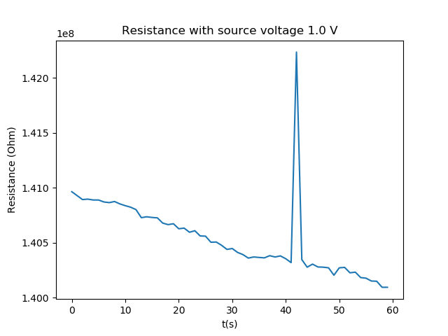
Top row measurements (test)
1231_1427_wo3196_r13
Two wire resistance measurements (voltage sourced)
No H2
Temperature setpoint is 25 C
Sample rate is 1 Hz
Measurement time is 60 s
Source voltage is 1.0 V
Limit current starts at 1.5e-08 A
Mean resistance is 1.41E+08 with std 3.34E+05

Slide 4
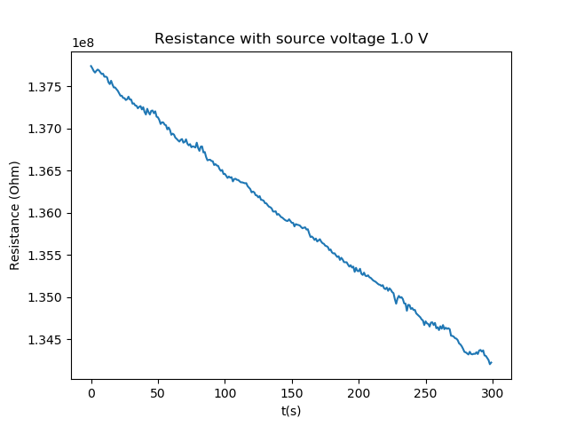
Top row measurements (5 min)
1231_1431_wo3196_r13
Temperature setpoint is 25 C
Sample rate is 1 Hz
Measurement time is 300 s
Source voltage is 1.0 V
Limit current starts at 1.5e-08 A
Mean resistance is 1.36E+08 with std 1.02E+06

Slide 5
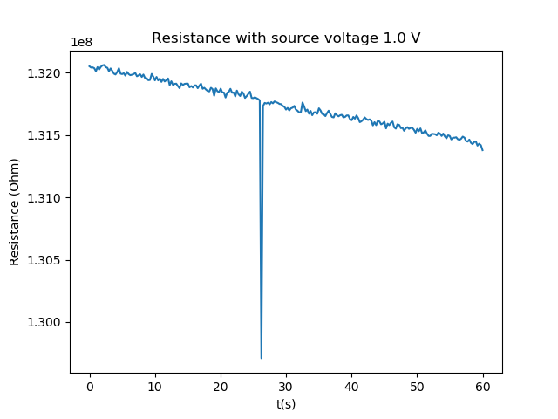
Top row measurements (10 Hz)
1231_1439_wo3196_r13
Same settings except for sample rate, which is now 10 Hz instead of 1 Hz
Temperature setpoint is 25 C
Sample rate is 10 Hz
Measurement time is 60 s
Source voltage is 1.0 V
Limit current starts at 1.5e-08 A
Mean resistance is 1.32E+08 with std 2.24E+05

Slide 6
Device #2

